Slide 1
A (Brief) Introduction to SEM
DATA 695 Research Capstone Project
David Errington
Master of Data Science & Analytics Student
Faculty of Graduate Studies
June 13, 2025

Slide 2
Table of Contents
Territorial Acknowledgment
Chapter 1: Introduction, Background, & Review
Review of Simple/Multiple Regression
Linear Regression as a Structural Equation Model
Limitations of Multiple Regression
Chapter 2: Path Analysis
Chapter 3: Confirmatory vs. Exploratory Factor Analysis
Chapter 4: Structural Equation Models w/ Latent Variables
References

Slide 3


Slide 4
Chapter 1: Introduction, Background, & Review

Slide 5
What is Structural Equation Modelling?
“Structural equation modeling is a linear model framework that models both simultaneous regression equations with latent variables.”
— Johnny Lin, PhD (2024)

Slide 6
What is Structural Equation Modelling?
SEM
Two or more endogenous variables
Observed variables
Latent variables
One endogenous variable
Observed variables
One exogenous variable
Multiple regression
Simple regression
Exogenous to endogenous
Multivariate regression
Path analysis
Endogenous to endogenous
Latent to observed
Latent to latent
Factor analysis
Structural regression
Two or more exogenous variables

Slide 7

What is Structural Equation Modelling?
EVERYTHING THE LIGHT TOUCHES IS OUR SEM.

Slide 8
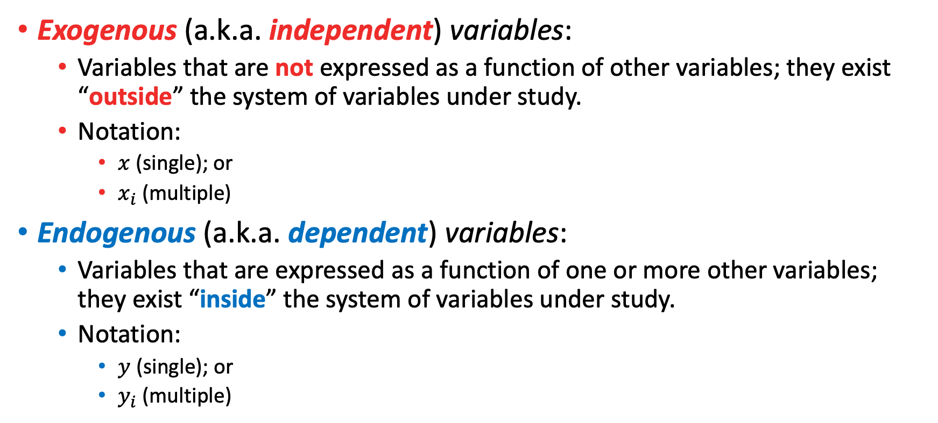
Definitions / Terminology
Exogenous (a.k.a. independent) variables:
Variables that are not expressed as a function of other variables; they exist “outside” the system of variables under study.
Notation:
$x$ (single); or
$x_{i}$ (multiple)
Endogenous (a.k.a. dependent) variables:
Variables that are expressed as a function of one or more other variables; they exist “inside” the system of variables under study.
Notation:
$y$ (single); or
$y_{i}$ (multiple)

Slide 9
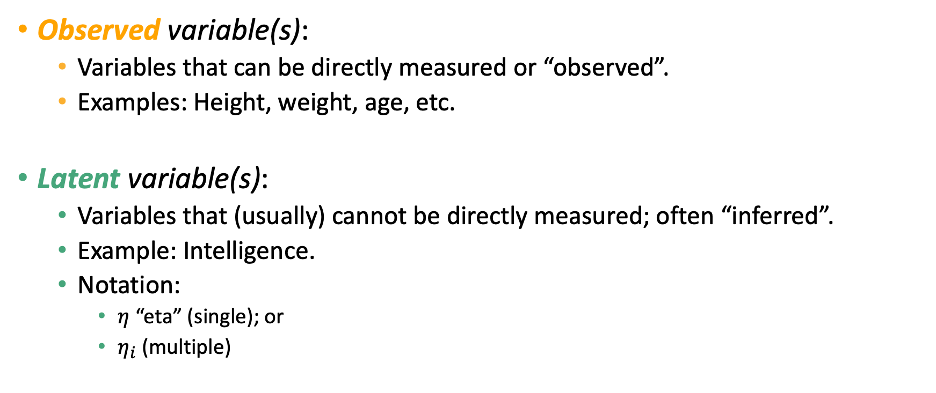
Definitions / Terminology
Observed variable(s):
Variables that can be directly measured or “observed”.
Examples: Height, weight, age, etc.
Latent variable(s):
Variables that (usually) cannot be directly measured; often “inferred”.
Example: Intelligence.
Notation:
$η$ “eta” (single); or
$η_{i}$ (multiple)

Slide 10
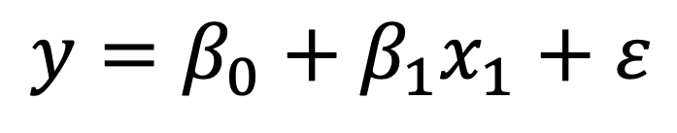
Linear Regression as a Structural Equation Model
Step 1: Start with linear regression equation.
$$y=β_{0}+β_{1}x_{1}+ε$$

Slide 11
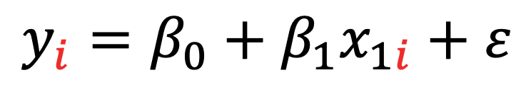

Linear Regression as a Structural Equation Model
Step 2: Add subscript $i$ to each variable.
$$y_{i}=β_{0}+β_{1}x_{1i}+ε$$

Slide 12

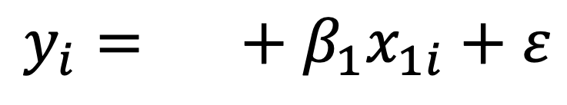
Linear Regression as a Structural Equation Model
Step 3: Take the intercept…
$$β_{0}$$
$$y_{i}=β_{0}+β_{1}x_{1i}+ε$$
Intercept

Slide 13


Linear Regression as a Structural Equation Model
Step 3: And replace it with $α$.
$$α$$
$$y_{i}=β_{0}+β_{1}x_{1i}+ε$$
Intercept

Slide 14
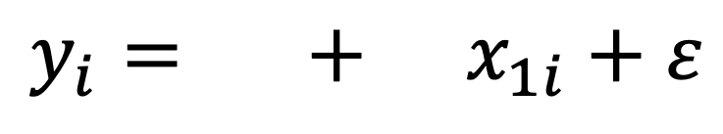
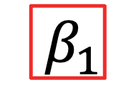
Linear Regression as a Structural Equation Model
Step 4: Take the regression coefficient(s)...
$$α$$
$${ β}_{1}$$
$$y_{i}=β_{0}+β_{1}x_{1i}+ε$$
Intercept
Coefficient

Slide 15

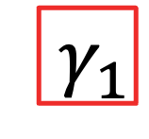
Linear Regression as a Structural Equation Model
Step 4: And replace it(them) with $γ$.
$$α$$
$${ γ}_{1}$$
$$y_{i}=β_{0}+β_{1}x_{1i}+ε$$
Intercept
Coefficient

Slide 16
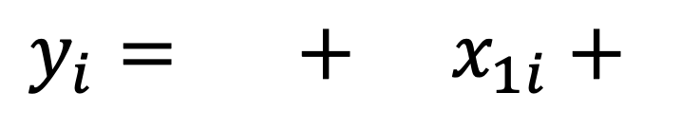

Linear Regression as a Structural Equation Model
Step 5: Take the residual error term...
Error
$$α$$
$${ γ}_{1}$$
$$ε$$
$$y_{i}=β_{0}+β_{1}x_{1i}+ε$$
Intercept
Coefficient

Slide 17


Linear Regression as a Structural Equation Model
Step 5: And replace it with $ζ_{i}$.
Error
$$α$$
$${ γ}_{1}$$
$$ζ_{i}$$
$$y_{i}=β_{0}+β_{1}x_{1i}+ε$$
Intercept
Coefficient

Slide 18
References
Lin, J. (2024). Introduction to Structural Equation Modeling (SEM) in R with lavaan. OARC Stats – Statistical Consulting Web Resources | UCLA. https://stats.oarc.ucla.edu/r/seminars/rsem/

